Slide 1

Basics of ‘C’

Slide 2
History of C
Structure of a ‘C’ Program
Compiling and executing C Program, program’s components
Variables
Numeric data types
Constants
Statements
Expressions
Operators
  Arithmetic
  Relational
  Logical
  Bitwise operators
Input, output formatting
file I/O.

Slide 3
General Aspect of ‘C’
C was originally developed in the 1970s, by Dennis Ritchie at Bell Telephone Laboratories, Inc.
C is a High level , general –purpose structured programming language. Instructions of C consists of terms that are very closely same to algebraic expressions, consisting of certain English keywords such as if, else, for ,do and while
C contains certain additional features that allows it to be used at a lower level , acting as bridge between machine language and the high level languages.
This allows C to be used for system programming as well as for applications programming
history

Slide 4
The Character set of ‘C’
C language consist of some characters set, numbers and
some special symbols. The character set of C consist of all the alphabets of English language. C consist of
Alphabets a to z, A to Z
Numeric 0,1 to 9
Special Symbols {,},[,],?,+,-,*,/,%,!,;,and more
The words formed from the character set are building
blocks of C and are sometimes known as tokens. These
tokens represent the individual entity of language. The
following different types of token are used in C
1) Identifiers 2)Keywords 3)Constants
4) Operators 5)Punctuation Symbols

Slide 5
Identifiers
A 'C' program consist of two types of elements ,
  user defined
  system defined.
Identifiers is nothing but a name given to these element
An identifier is a word used by a programmer to name a variable , function, or label.
identifiers consist of letters and digits, in any order, except that the first character or label.
Identifiers consist of letters and digits if any order, except that the first character must be letter.
Both Upper and lowercase letters can be used
C is case sensitive upper case (capital) or lower case letters are considered different characters. Average, average and AVERAGE are three different identifiers
Examples of Valid C identifier
length - It contains only lowercase alphabets.
total_sum - It contains only '_' as a special character.
_size - It starts with an underscore '_'. * len_ - Contains lowercase alphabets and an underscore.
num1 - Here, the numeric digit comes at the end.
num_2 - It starts with lowercase and ends with a digit.
Invalid Identifiers in C
The Invalid identifiers are those identifiers that do not follow every single rule of the naming convention of identifiers.
Example of Invalid C identifier
5size (it begins with a digit)
\@hello (starts with a special character other than '_')
int ( it is a keyword)
m n (contains a blank space)
m+n (contains a special character)

Slide 6
Keywords
Keywords are nothing but system defined identifiers.
Keywords are reserved words of the language.
They have specific meaning in the language and cannot be used by the programmer as variable or constant names
C is case senitive, it means these must be used as it is
32 Keywords in C Programming
auto | double | int | struct
break | else | long | switch
case | enum | register | typedef
char | extern | return | union
const | float | short | unsigned
continue | for | signed | void
default | goto | sizeof | volatile
do | if | static | while

Slide 7
Comments in C
Comments can be used to explain code, and to make it more readable. It can also be used to prevent execution when testing alternative code.
Comments can be singled-lined or multi-lined.
  Single-line Comments
  Single-line comments start with two forward slashes (//).
Any text between // and the end of the line is ignored by the compiler (will not be executed).
This example uses a single-line comment before a line of code:
Example
// This is a comment
printf("Hello World!"); // This is a comment
C Multi-line Comments
Multi-line comments start with /* and ends with */.
Any text between /* and */ will be ignored by the compiler:
Example
/* The code below will print the words Hello World!
to the screen, and it is amazing */
printf("Hello World!");

Slide 8
Variables
A variable is nothing but a name given to a storage area that our programs can manipulate. Each variable in C has a specific type, which determines the size and layout of the variable's memory; the range of values that can be stored within that memory; and the set of operations that can be applied to the variable.
The name of a variable can be composed of letters, digits, and the underscore character. It must begin with either a letter or an underscore. Upper and lowercase letters are distinct because C is case-sensitive.
Syntax
  type variableName = value;
  // Declare a variable
  int myNum;
  // Assign a value to the variable
  myNum = 15;
Eg: int myNum = 15;
int a=10,b=20;//declaring 2 variable of integer type
float f=20.8;
char c='A';

Slide 9
Rules for defining variables
A variable can have alphabets, digits, and underscore.
A variable name can start with the alphabet, and underscore only. It can't start with a digit.
No whitespace is allowed within the variable name.
A variable name must not be any reserved word or keyword, e.g. int, float, etc.

Slide 10
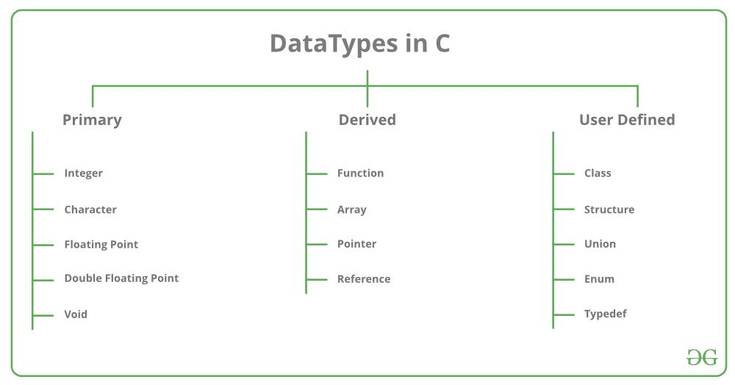
Data types in C

Slide 11
Different data type
Character (char):
We use the keyword char for the character data type.
It is used to store single-bit characters and occupies 1 byte of memory.
You can store alphabets from A-Z(and a-z) and 0-9 digits using char datatype. For example,
For char b = 'A';
char c = '0';
char d = 0; // ERROR
4.char datatype, it is necessary to enclose the data within single quotes.
You can perform addition and subtraction operations on char datatype values.
The ASCII value of a char datatype value should not exceed 127.

Slide 12
Integer (int):
Integer (int):
We use the keyword int for the integer data type.
The int data type is used to store non-fractional numbers which include positive, negative, and zero values.
The range of int is -2,147,483,648 to 2,147,483,647 and it occupies 2 or 4 bytes of memory, depending on the system you’re using. For example,
int a = 5550;
int b = -90,
int c = 0;
int d = -0.5; //invalid
We can perform addition, subtraction, division, multiplication, bitwise, and modulo operations on int data type.

Slide 13
Floating-point (float):
We use the keyword float for a floating-point data type.
The keyword float is used to store decimal numbers.
It occupies 4 bytes of memory and ranges from 1e-37 to 1e+37.
For example,
float a = 0.05;
float b = -0.005.
float c = 1; // it will become c = 1.000000 because of type-casting
We can perform addition, subtraction, division, and multiplication operations on float data type.

Slide 14
Double (double):
We use the keyword double for the double data type.
The double datatype is used to store decimal numbers.
It occupies 8 bytes of memory and ranges from 1e-37 to 1e+37.
Here is how we use it in code,
double a = 10.09;
double b = -67.9;
The double datatype has more precision than float so double gives more accurate results as compared to float.
We can perform addition, subtraction, division, and multiplication operations on double data type.

Slide 15
Void (void):
This means no value.
This data type is mostly used when we define functions.
The void datatype is used when a function does not return any result.
It occupies 0 bytes of memory.
We use the void keyword for void data type.
Here is how we use the void type with functions,
void function() {
//your code goes here
}

Slide 16
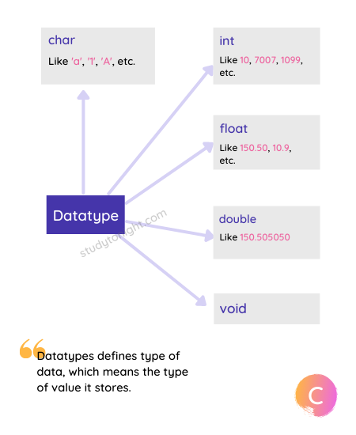

Slide 17
C Data type Value Range
Type | Typical Size in Bits | Minimal Range | Format Specifier
char | 8 | -127 to 127 | %c
unsigned char | 8 | 0 to 255 | %c
signed char | 8 | -127 to 127 | %c
int | 16 or 32 | -32,767 to 32,767 | %d, %i
unsigned int | 16 or 32 | 0 to 65,535 | %u
signed int | 16 or 32 | Same as int | %d, %i
short int | 16 | -32,767 to 32,767 | %hd
unsigned short int | 16 | 0 to 65,535 | %hu
signed short int | 16 | Same as short int | %hd
long int | 32 | -2,147,483,647 to 2,147,483,647 | %ld, %li
long long int | 64 | -(2⁶³ - 1) to 2⁶³ - 1 (Added by C99 standard) | %lld, %lli
signed long int | 32 | Same as long int | %ld, %li
unsigned long int | 32 | 0 to 4,294,967,295 | %lu
unsigned long long int | 64 | 2⁶⁴ - 1 (Added by C99 standard) | %llu
float | 32 | 1E-37 to 1E+37 with six digits of precision | %f
double | 64 | 1E-37 to 1E+37 with ten digits of precision | %lf
long double | 80 | 1E-37 to 1E+37 with ten digits of precision | %Lf

Slide 18
What happens if the value is out of Range?
#include <stdio.h>
int main() {
// allowed value up to 65535
unsigned short int x = 65536;
return 0;
}
warning: large integer implicitly truncated to unsigned type [-Woverflow]
unsigned short int x = 65536;

Slide 19
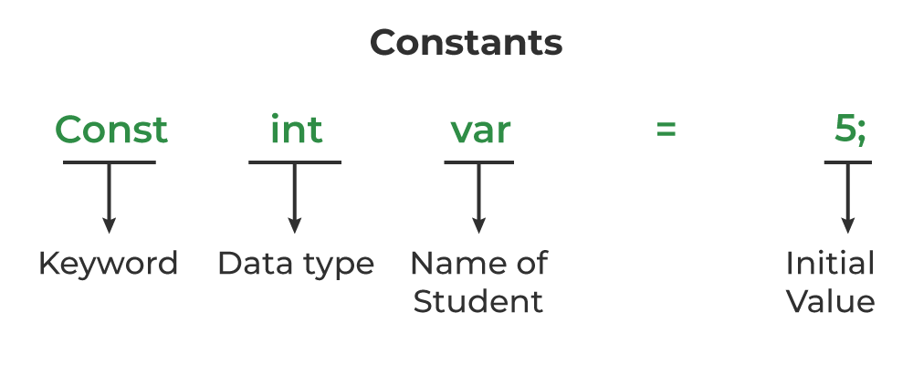
Constants
The constants in C are the read-only variables whose values cannot be modified once they are declared in the C program. The type of constant can be an integer constant, a floating pointer constant, a string constant, or a character constant. In C language, the const keyword is used to define the constants.
Syntax to Define Constant
const data_type var_name = value;
#define const_name value
#define pi 3.14

Slide 20
Types of Constants in C
The type of the constant is the same as the data type of the variables. Following is the list of the types of constants
Integer Constant
Character Constant
Floating Point Constant
Double Precision Floating Point Constant
Array Constant
Structure Constant

Slide 21
Properties of Constant in C
1. Initialization with Declaration
We can only initialize the constant variable in C at the time of its declaration. Otherwise, it will store the garbage value.
2. Immutability
The constant variables in c are immutable after its definition, i.e., they can be initialized only once in the whole program. After that, we cannot modify the value stored inside that variable.
#include <stdio.h>
int main()
{
// declaring a constant variable
const int var;
// initializing constant variable var after declaration
var = 20;
printf("Value of var: %d", var);
return 0;
}

Slide 22
Literals
The value stored in a constant variable is known as a literal. However, constants and literals are often considered synonyms. Literals can be classified on the basis of datatypes.
Types of literals:
Integer literals
Floating-point literals
Characters literals
Strings literals
Boolean literals
User-defined literals

Slide 23

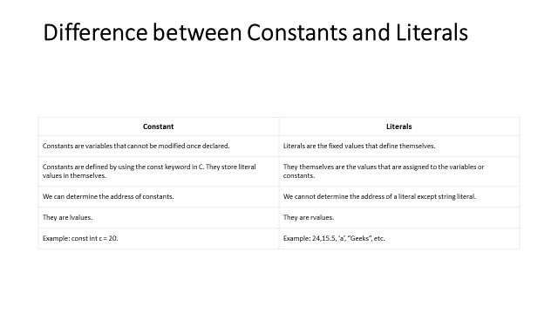

Slide 24
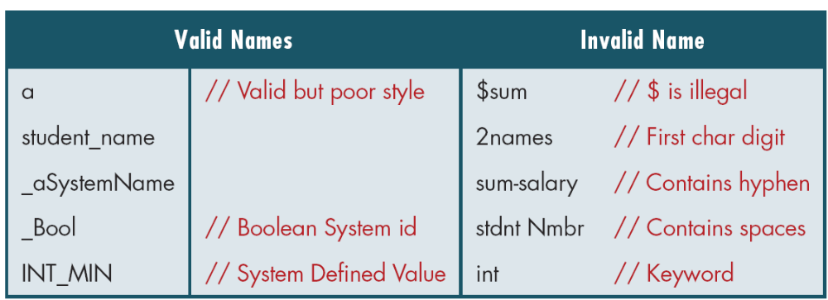
Examples of Valid and Invalid Names

Slide 25
Constants
Floating-point constants
A floating point constant is a numeric constant that has either a fractional form or an exponent form. For example: 2.0,0.0000234,-0.22E-5
Character constants
A character constant is a constant which uses single quotation around characters. For example: 'a', 'l', 'm', 'F'
String constants
String constants are the constants which are enclosed in a pair of double-quote marks. For example: "good" ,"x","Earth is round\n"

Slide 26
Escape Sequences
Sometimes, it is necessary to use characters which cannot be typed or has special meaning in C programming. For example: newline(enter), tab, question mark etc. In order to use these characters, escape sequence is used.
For example: \n is used for newline. The backslash ( \ ) causes "escape" from the normal way the characters are interpreted by the compiler.Escape
Sequences Character
\b Backspace
\f Form feed
\n Newline
\r Return
\t Horizontal tab
\v Vertical tab
\\ Backslash
\' Single quotation mark
\" Double quotation mark
\? Question mark
\0 Null character

Slide 27
statements
A statement is a command given to the computer that instructs the computer to take a specific action
C statements consist of tokens, expressions, and other statements. A statement that forms a component of another statement is called the "body" of the enclosing statement.
Types of statements
1.Labeled Statements
2.Compound Statements: A compound statement is the way C groups multiple statements into a single statement
3.Expression Statements:
4.Selection Statements: if, if else, switch
5.Iteration Statements: While, do while and for
6.Jump Statements: goto break , continue and return
An expression statement consists of an optional expression followed by a semicolon (;)

Slide 28
C Expression
C expression consists of operators, constants, and variables which are arranged according to the rules of the language. It can also contain function calls which return values. An expression can consist of one or more operands, zero or more operators to compute a value. Every expression produces some value which is assigned to the variable with the help of an assignment operator.
Examples of C expression:
(a+b) - c
(x/y) -z
4a2 - 5b +c
(a+b) * (x+y)

Slide 29
Operators in C:An operator is a symbol which operates on a value or a variable. For example: + is an operator to perform addition.
C programming has wide range of operators to perform various operations. For better understanding of operators, these operators can be classified as:
Arithmetic Operators
Increment and Decrement Operators
Assignment Operators
Relational Operators
Logical Operators
Conditional Operators
Bitwise Operators
Special Operators

Slide 30
Arithmetic Operator
A holds 10 and variable B holds 20
Operator | Description | Example
+ | Adds two operands. | A + B = 30
− | Subtracts second operand from the first. | A − B = -10
* | Multiplies both operands. | A * B = 200
/ | Divides numerator by de-numerator. | B / A = 2
% | Modulus Operator and remainder of after an integer division. | B % A = 0
++ | Increment operator increases the integer value by one. | A++ = 11
-- | Decrement operator decreases the integer value by one. | A-- = 9

Slide 31
Increment and Decrement Operators
1. C programming has two operators increment ++ and decrement -- to change the value of an operand (constant or variable) by 1.
2. Increment ++ increases the value by 1 whereas decrement -- decreases the value by 1.
3. These two operators are unary operators, meaning they only operate on a single operand.
eg. int a=10, b=100
++a = 11
--b = 99

Slide 32
int main()
{
int a = 10, b = 100;
float c = 10.5, d = 100.5;
printf("++a = %d \n", ++a);
printf("--b = %d \n", --b);
printf("++c = %f \n", ++c);
printf("--d = %f \n", --d);
return 0;
}

Slide 33
C Assignment Operators
An assignment operator is used for assigning a value to a variable. The most common assignment operator is =
Operator Example Same as
= a = b a = b
+= a += b a = a+b
-= a -= b a = a-b
*= a *= b a = a*b
/= a /= b a = a/b
%= a %= b a = a%b

Slide 34
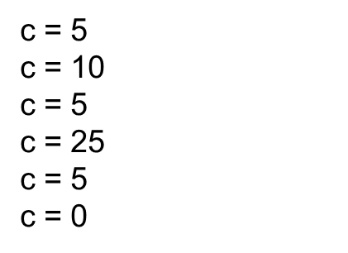
// Working of assignment operators
#include <stdio.h>
int main()
{
int a = 5, c;
c = a; // c is 5
printf("c = %d\n", c);
c += a; // c is 10
printf("c = %d\n", c);
c -= a; // c is 5
printf("c = %d\n", c);
c *= a; // c is 25
printf("c = %d\n", c);
c /= a; // c is 5
printf("c = %d\n", c);
c %= a; // c = 0
printf("c = %d\n", c);
return 0;
}

Slide 35

C Relational Operators
A relational operator checks the relationship between two operands. If the relation is true, it returns 1; if the relation is false, it returns value 0.
Relational operators are used in decision making and loops.
operator | Description | Example
== | Checks if the values of two operands are equal or not. If yes, then the condition becomes true. | (A == B) is not true.
!= | Checks if the values of two operands are equal or not. If the values are not equal, then the condition becomes true. | (A != B) is true.
> | Checks if the value of left operand is greater than the value of right operand. If yes, then the condition becomes true. | (A > B) is not true.
< | Checks if the value of left operand is less than the value of right operand. If yes, then the condition becomes true. | (A < B) is true.
>= | Checks if the value of left operand is greater than or equal to the value of right operand. If yes, then the condition becomes true. | (A >= B) is not true.
<= | Checks if the value of left operand is less than or equal to the value of right operand. If yes, then the condition becomes true. | (A <= B) is true.

Slide 36
#include <stdio.h>
main() {
int a = 21;
int b = 10;
int c ;
if( a == b ) {
printf("Line 1 - a is equal to b\n" );
} else {
printf("Line 1 - a is not equal to b\n" );
}
if ( a < b ) {
printf("Line 2 - a is less than b\n" );
} else {
printf("Line 2 - a is not less than b\n" );
}
if ( a > b ) {
printf("Line 3 - a is greater than b\n" );
} else {
printf("Line 3 - a is not greater than b\n" );
}

Slide 37
/* Lets change value of a and b */
a = 5;
b = 20;
if ( a <= b ) {
printf("Line 4 - a is either less than or equal to b\n" );
}
if ( b >= a ) {
printf("Line 5 - b is either greater than or equal to b\n" );
}
}

Slide 38
/ Working of relational operators
#include <stdio.h>
int main()
{
int a = 5, b = 5, c = 10;
printf("%d == %d is %d \n", a, b, a == b);
printf("%d == %d is %d \n", a, c, a == c);
printf("%d > %d is %d \n", a, b, a > b);
printf("%d > %d is %d \n", a, c, a > c);
printf("%d < %d is %d \n", a, b, a < b);
printf("%d < %d is %d \n", a, c, a < c);
printf("%d != %d is %d \n", a, b, a != b);
printf("%d != %d is %d \n", a, c, a != c);
printf("%d >= %d is %d \n", a, b, a >= b);
printf("%d >= %d is %d \n", a, c, a >= c);
printf("%d <= %d is %d \n", a, b, a <= b);
printf("%d <= %d is %d \n", a, c, a <= c);
return 0;
}
5 == 5 is 1
5 == 10 is 0
5 > 5 is 0
5 > 10 is 0
5 < 5 is 0
5 < 10 is 1
5 != 5 is 0
5 != 10 is 1
5 >= 5 is 1
5 >= 10 is 0
5 <= 5 is 1
5 <= 10 is 1

Slide 39
Logical Operators
Operator | Description | Example
&& | Called Logical AND operator. If both the operands are non-zero, then the condition becomes true. | (A && B) is false.
|| | Called Logical OR Operator. If any of the two operands is non-zero, then the condition becomes true. | (A || B) is true.
! | Called Logical NOT Operator. It is used to reverse the logical state of its operand. If a condition is true, then Logical NOT operator will make it false. | !(A && B) is true.

Slide 40
//Working of logical operators
#include <stdio.h>
int main()
{
int a = 5, b = 5, c = 10, result;
result = (a == b) && (c > b);
printf("(a == b) && (c > b) is %d \n", result);
result = (a == b) && (c < b);
printf("(a == b) && (c < b) is %d \n", result);
result = (a == b) || (c < b);
printf("(a == b) || (c < b) is %d \n", result);
result = (a != b) || (c < b);
printf("(a != b) || (c < b) is %d \n", result);
result = !(a != b);
printf("!(a != b) is %d \n", result);
result = !(a == b);
printf("!(a == b) is %d \n", result);
return 0;
}
(a == b) && (c > b) is 1
(a == b) && (c < b) is 0
(a == b) || (c < b) is 1
(a != b) || (c < b) is 0
!(a != b) is 1
!(a == b) is 0

Slide 41
Assignment Operators
Operator | Description | Example
= | Simple assignment operator. Assigns values from right side operands to left side operand | C = A + B will assign the value of A + B to C
+= | Add AND assignment operator. It adds the right operand to the left operand and assign the result to the left operand. | C += A is equivalent to C = C + A
-= | Subtract AND assignment operator. It subtracts the right operand from the left operand and assigns the result to the left operand. | C -= A is equivalent to C = C - A
*= | Multiply AND assignment operator. It multiplies the right operand with the left operand and assigns the result to the left operand. | C *= A is equivalent to C = C * A
/= | Divide AND assignment operator. It divides the left operand with the right operand and assigns the result to the left operand. | C /= A is equivalent to C = C / A
%= | Modulus AND assignment operator. It takes modulus using two operands and assigns the result to the left operand. | C %= A is equivalent to C = C % A
<<= | Left shift AND assignment operator. | C <<= 2 is same as C = C << 2
>>= | Right shift AND assignment operator. | C >>= 2 is same as C = C >> 2
&= | Bitwise AND assignment operator. | C &= 2 is same as C = C & 2
^= | Bitwise exclusive OR and assignment operator. | C ^= 2 is same as C = C ^ 2
|= | Bitwise inclusive OR and assignment operator. | C |= 2 is same as C = C | 2

Slide 42
Operators Precedence in C
Category | Operator | Associativity
Postfix | () [] -> . ++ - - | Left to right
Unary | + - ! ~ ++ - - (type)* & sizeof | Right to left
Multiplicative | * / % | Left to right
Additive | + - | Left to right
Shift | << >> | Left to right
Relational | < <= > >= | Left to right
Equality | == != | Left to right
Bitwise AND | & | Left to right
Bitwise XOR | ^ | Left to right
Bitwise OR | | | Left to right
Logical AND | && | Left to right
Logical OR | || | Left to right
Conditional | ?: | Right to left
Assignment | = += -= *= /= %=>>= <<= &= ^= |= | Right to left
Comma | , | Left to right

Slide 43
#include <stdio.h>
main() {
int a = 20;
int b = 10;
int c = 15;
int d = 5;
int e;
e = (a + b) * c / d; // ( 30 * 15 ) / 5
printf("Value of (a + b) * c / d is : %d\n", e );
e = ((a + b) * c) / d; // (30 * 15 ) / 5
printf("Value of ((a + b) * c) / d is : %d\n" , e );
e = (a + b) * (c / d); // (30) * (15/5)
printf("Value of (a + b) * (c / d) is : %d\n", e );
e = a + (b * c) / d; // 20 + (150/5)
printf("Value of a + (b * c) / d is : %d\n" , e );
return 0;
}

Slide 44
C Programs
It's time to write your first C program.
Topics discussed in this section:
Structure of a C Program
Your First C Program
Comments
The Greeting Program

Slide 45
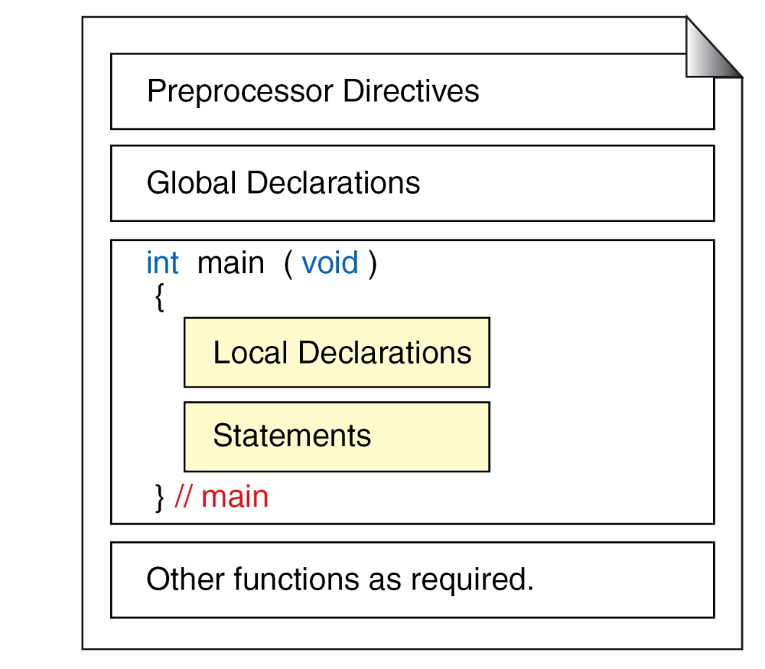
Structure of a C Program

Slide 46
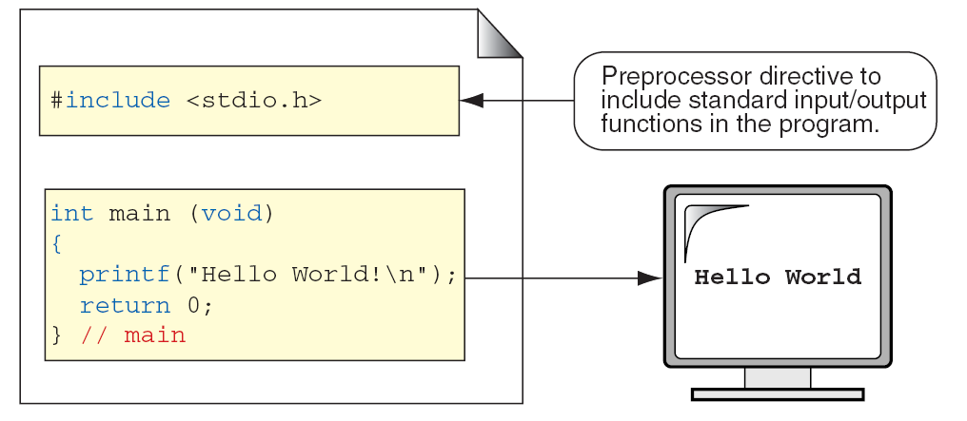
The Greeting Program

Slide 47
Compilation ensures that the source code adheres to the Syntax. If any code does not follow Syntax, a compilation error will be generated. Execution is the process of running a.exe file for Windows or a.extension file for a different operating system.
After the syntax errors are traced out a source file is passed through a compiler which first translates high level language into object code (A machine code not ready to be executed).

Slide 48
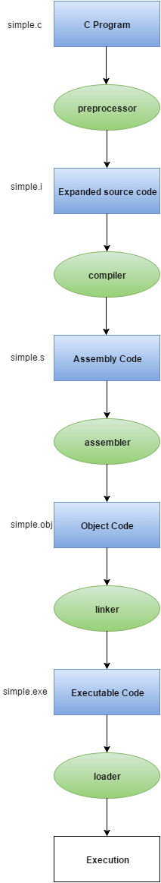

Slide 49
Pre-processing
The preprocessor is responsible to convert preprocessor directives into their respective values. .This is the first phase through which source code is passed. This phase includes:
Removal of Comments
Expansion of Macros
Expansion of the included files.
Conditional compilation
The preprocessed output is stored in the filename.i

Slide 50
compilation
compilation is the process where the compiler checks whether the program is correct syntax-wise and whether there are no errors in the syntax.
If there is any mistake found in the syntax then it will throw the errors. The error thrown at the time of compilation is called a Compile-time error.

Slide 51
Assembling
In this phase the filename.s is taken as input and turned into filename.o by the assembler. This file contains machine-level instructions. At this phase, only existing code is converted into machine language, and the function calls like printf() are not resolved

Slide 52
Linker
First of all, let us know that library functions are not a part of any C program but of the C software. Thus, the compiler doesn’t know the operation of any function, whether it be printf or scanf. The definitions of these functions are stored in their respective library which the compiler should be able to link. This is what the Linker does. So, when we write #include, it includes stdio.h library which gives access to Standard Input and Output. The linker links the object files to the library functions and the program becomes a .exe file. Here, first.exe will be created which is in an executable format.
A linker then links the object code with pre-compiled library functions, thus creating an executable program.
Linker | Loader
Linker generates the executable module of a source program. | Loader loads the executable module to the main memory for execution.
Linker takes the object code generated by an assembler, as input. | Loader takes executable module generated by a linker as input.
Linker combines all the object modules of a source code to generate an executable module. | Loader allocates the addresses to an executable module in main memory for execution.

Slide 53
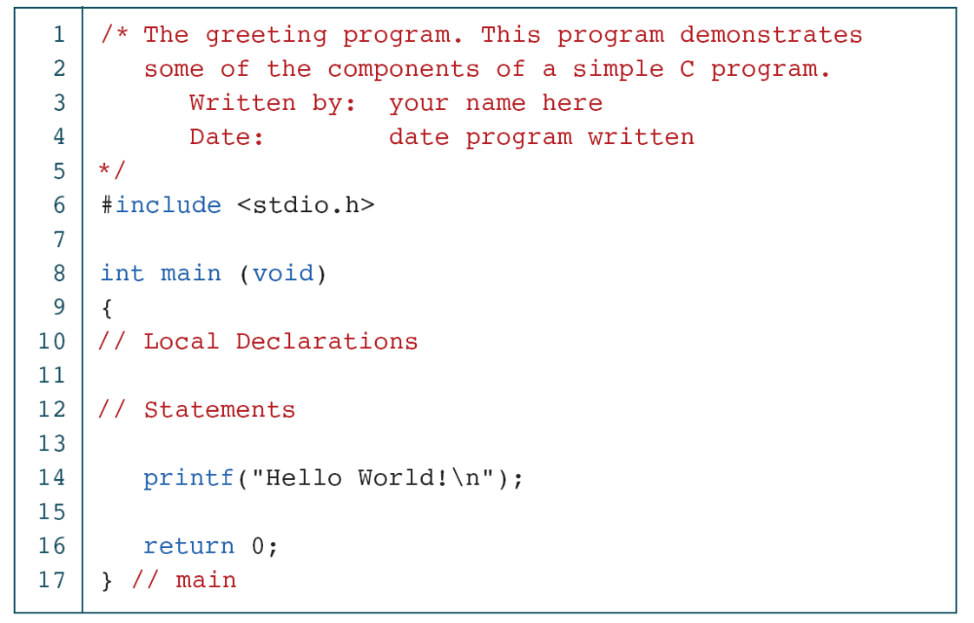
The Greeting Program

Slide 54
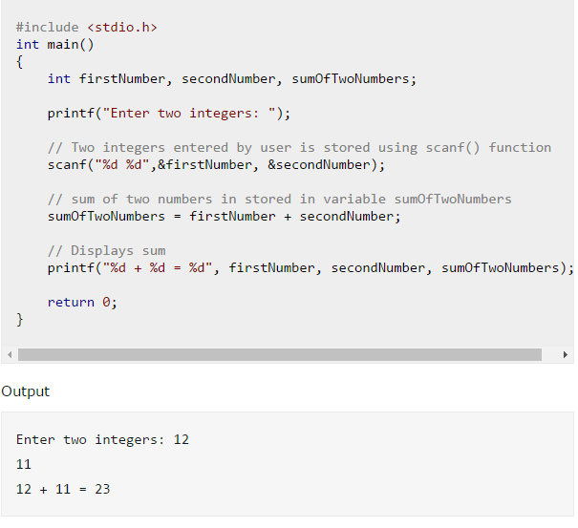
Example : Program To Add Two Integers

Slide 55
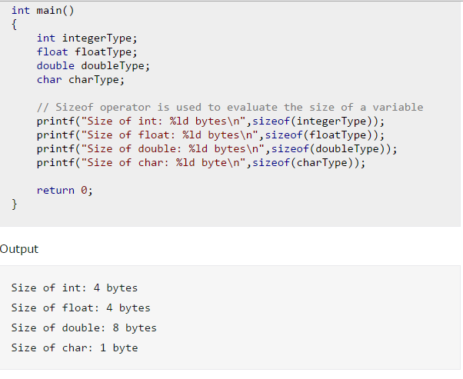
C Program to Find the Size of int, float, double and char

